Slide 1
Census Income Prediction Identifying Characteristics of High Earners US Census Bureau Income Analysis
Date: October 24, 2025

Slide 2
Agenda
1. Project Background & Objectives
2. Dataset Overview
3. Exploratory Data Analysis
4. Data Preprocessing & Feature Engineering
5. Model Development & Comparison
6. Results & Key Findings
7. Feature Importance Analysis
8. Business Recommendations
9. Limitations
10. Q&A

Slide 3
1. Project Background
The Challenge
- US Census Bureau collects demographic and economic data to inform strategic initiatives
- Need to understand factors that influence income levels
- Binary classification: Predict whether individuals earn <$50K or ≥$50K annually
Objectives
- Identify key characteristics associated with income levels
- Build predictive models to classify income brackets
- Provide actionable insights for policy decisions
- Deliver production-ready, replicable solution

Slide 4
2. Dataset Overview
Data Characteristics
- Source: US Census Bureau (1994-1995)
- Training Set: 199,523 records
- Test Set: 99,762 records
- Features: 42 variables
- 7 continuous (age, capital gains, weeks worked, etc.)
- 33 nominal (education, occupation, marital status, etc.)
- 2 derived (target income, year)

Slide 5
2. Dataset Overview
Target Variable Distribution
- Less than $50K: 93.8% (187,141 records)
- $50K or more: 6.2% (12,382 records)
- Challenge: Severe class imbalance (15:1 ratio)
- Solution: SMOTE balancing applied to training data

Slide 6
3. Exploratory Data Analysis
Key Observations
Data Quality
- Minimal missing data (only 874 missing values in hispanic_origin)
- 1.62% duplicates in training set (kept to preserve population distribution)
- Clean categorical encoding needed
- Age binning proven relevant: 16.1% income rate difference across age groups
Continuous Features
- Age: Range 0-90, mean 34.5 years
- Weeks worked: Highly bimodal (0 or 52 weeks)
- Capital gains/losses: Extremely right-skewed (most zeros)
- Dividends: Similar pattern to capital gains

Slide 7
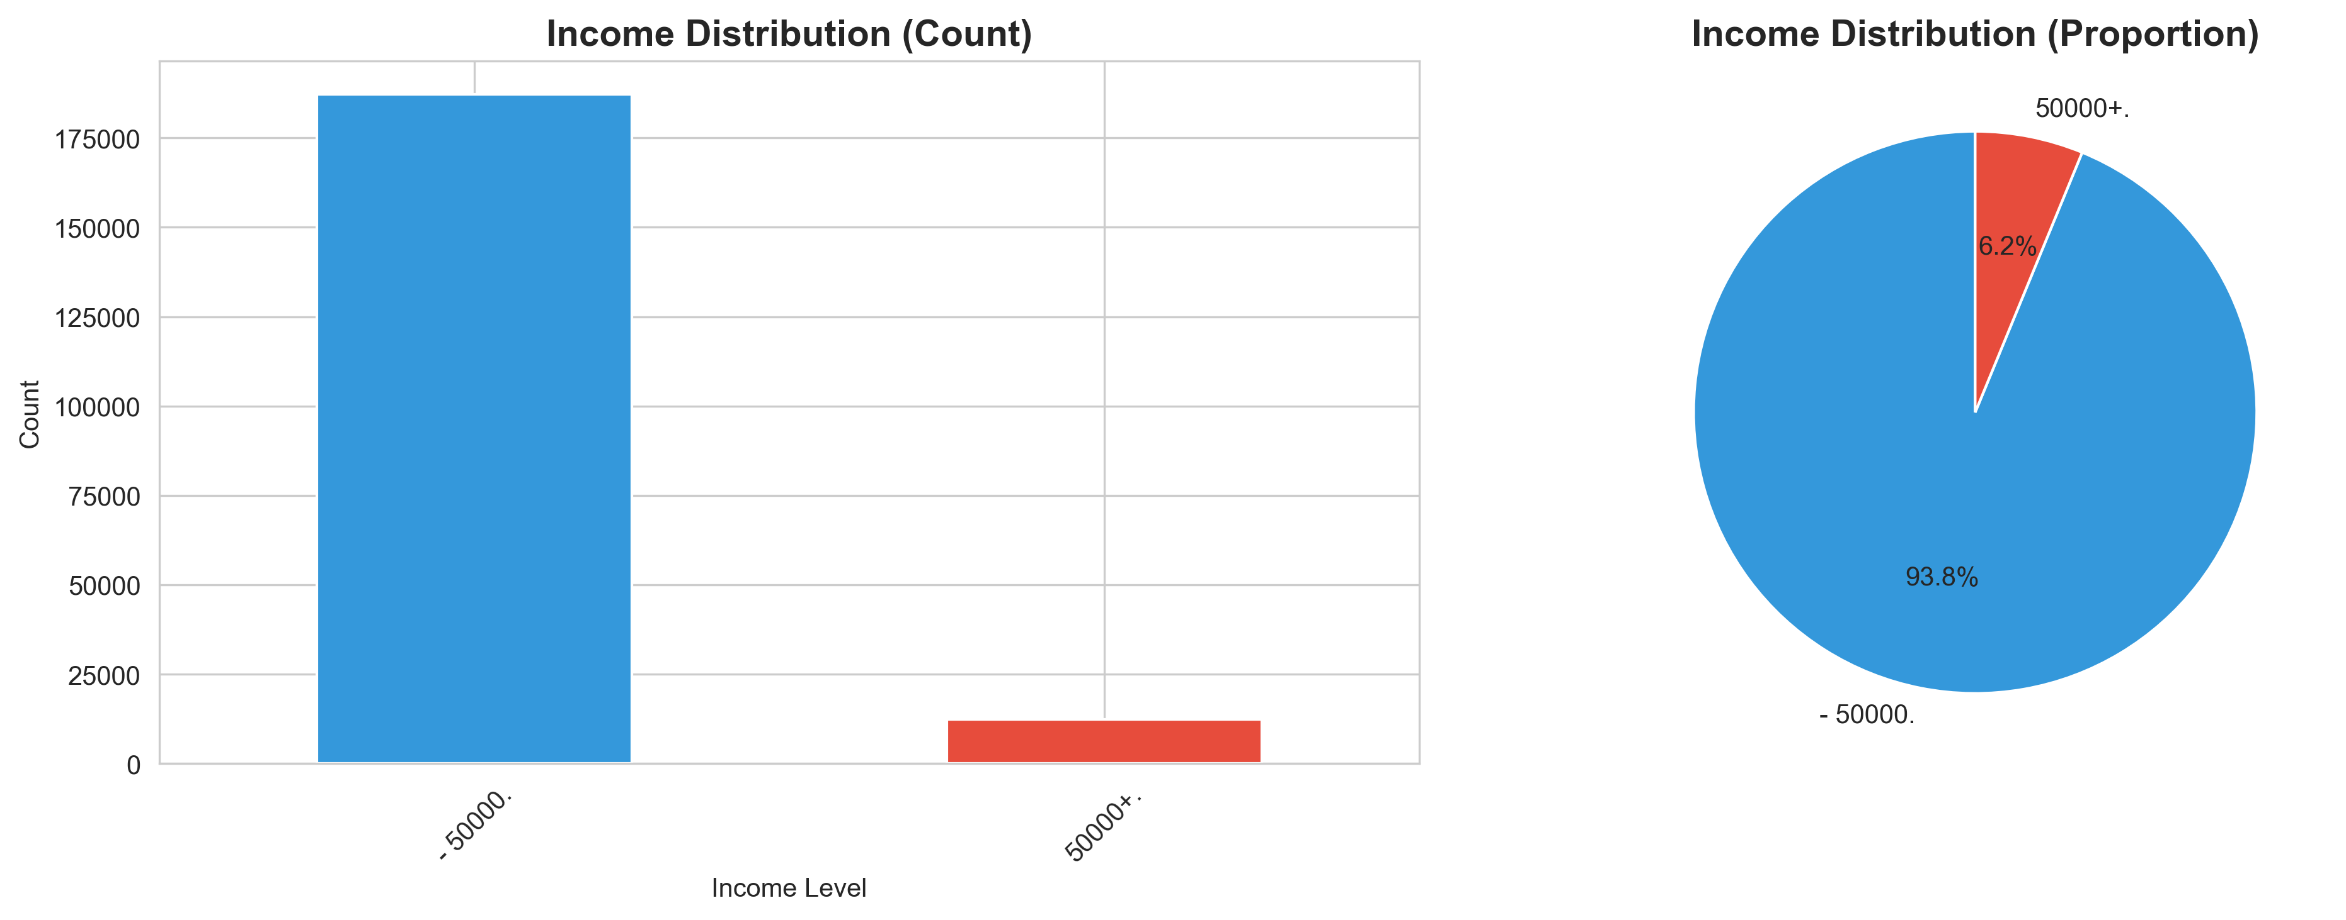
3. EDA - Visualizations
Income Distribution

Slide 8
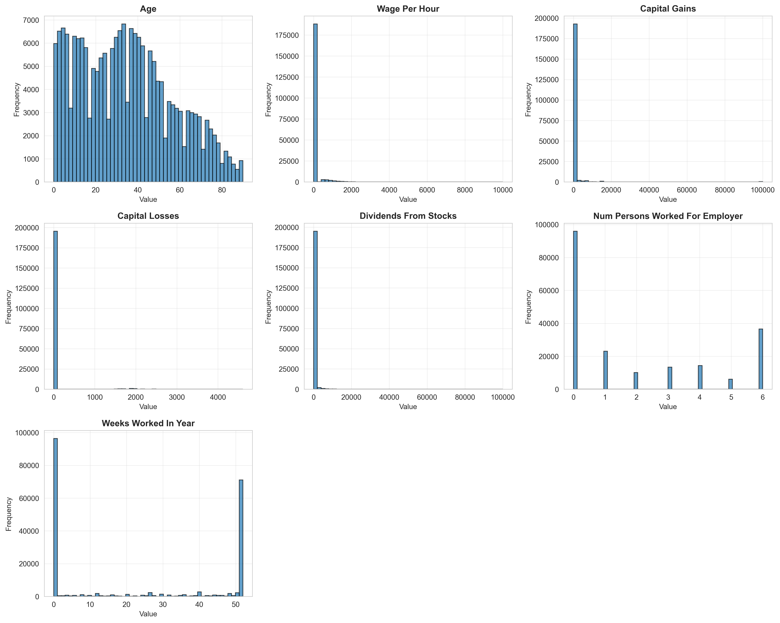
3. EDA - Continuous Features
Key Insights:
- Age shows normal-like distribution
- Financial features (capital, dividends) heavily right-skewed
- Weeks worked is bimodal (unemployed vs full-time)

Slide 9
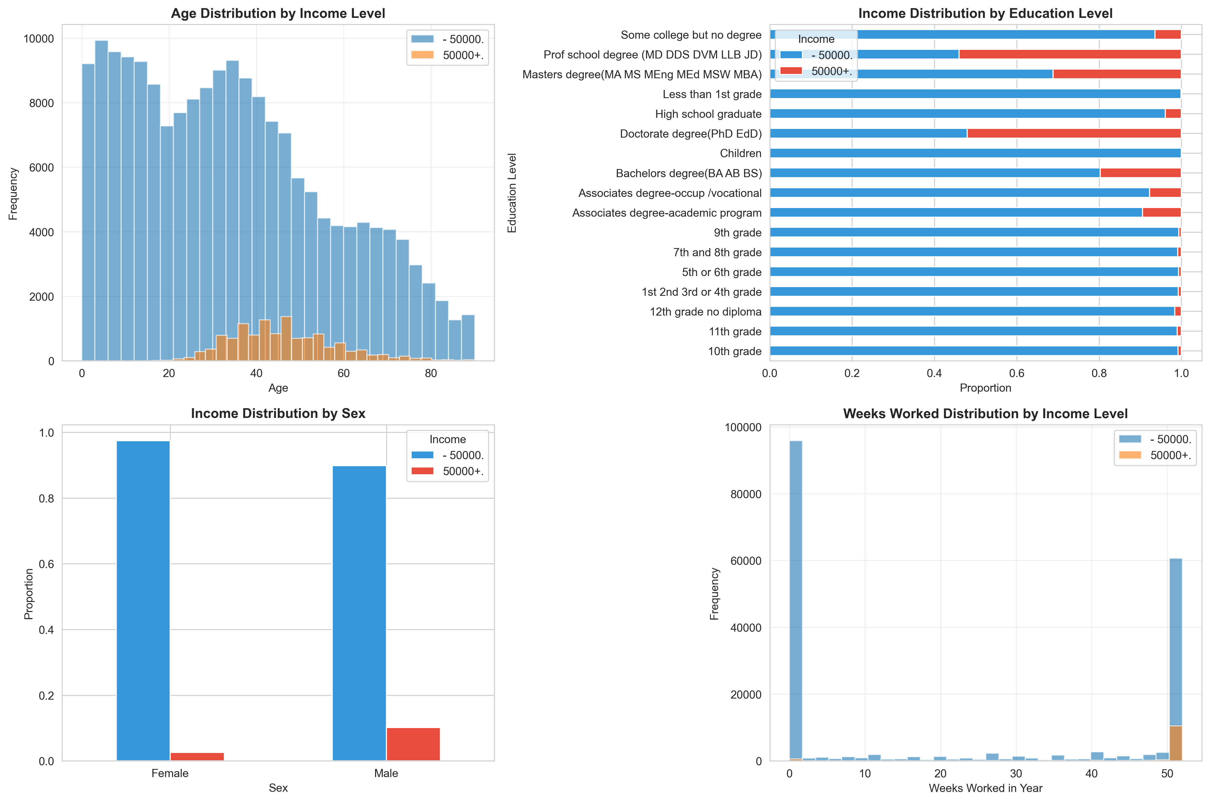
3. EDA - Feature vs Target
Key Insights:
- Higher earners concentrated in ages 35-55
- Education level strongly correlates with income
- Gender gap visible in income distribution
- Full-year workers (52 weeks) more likely to earn ≥$50K

Slide 10
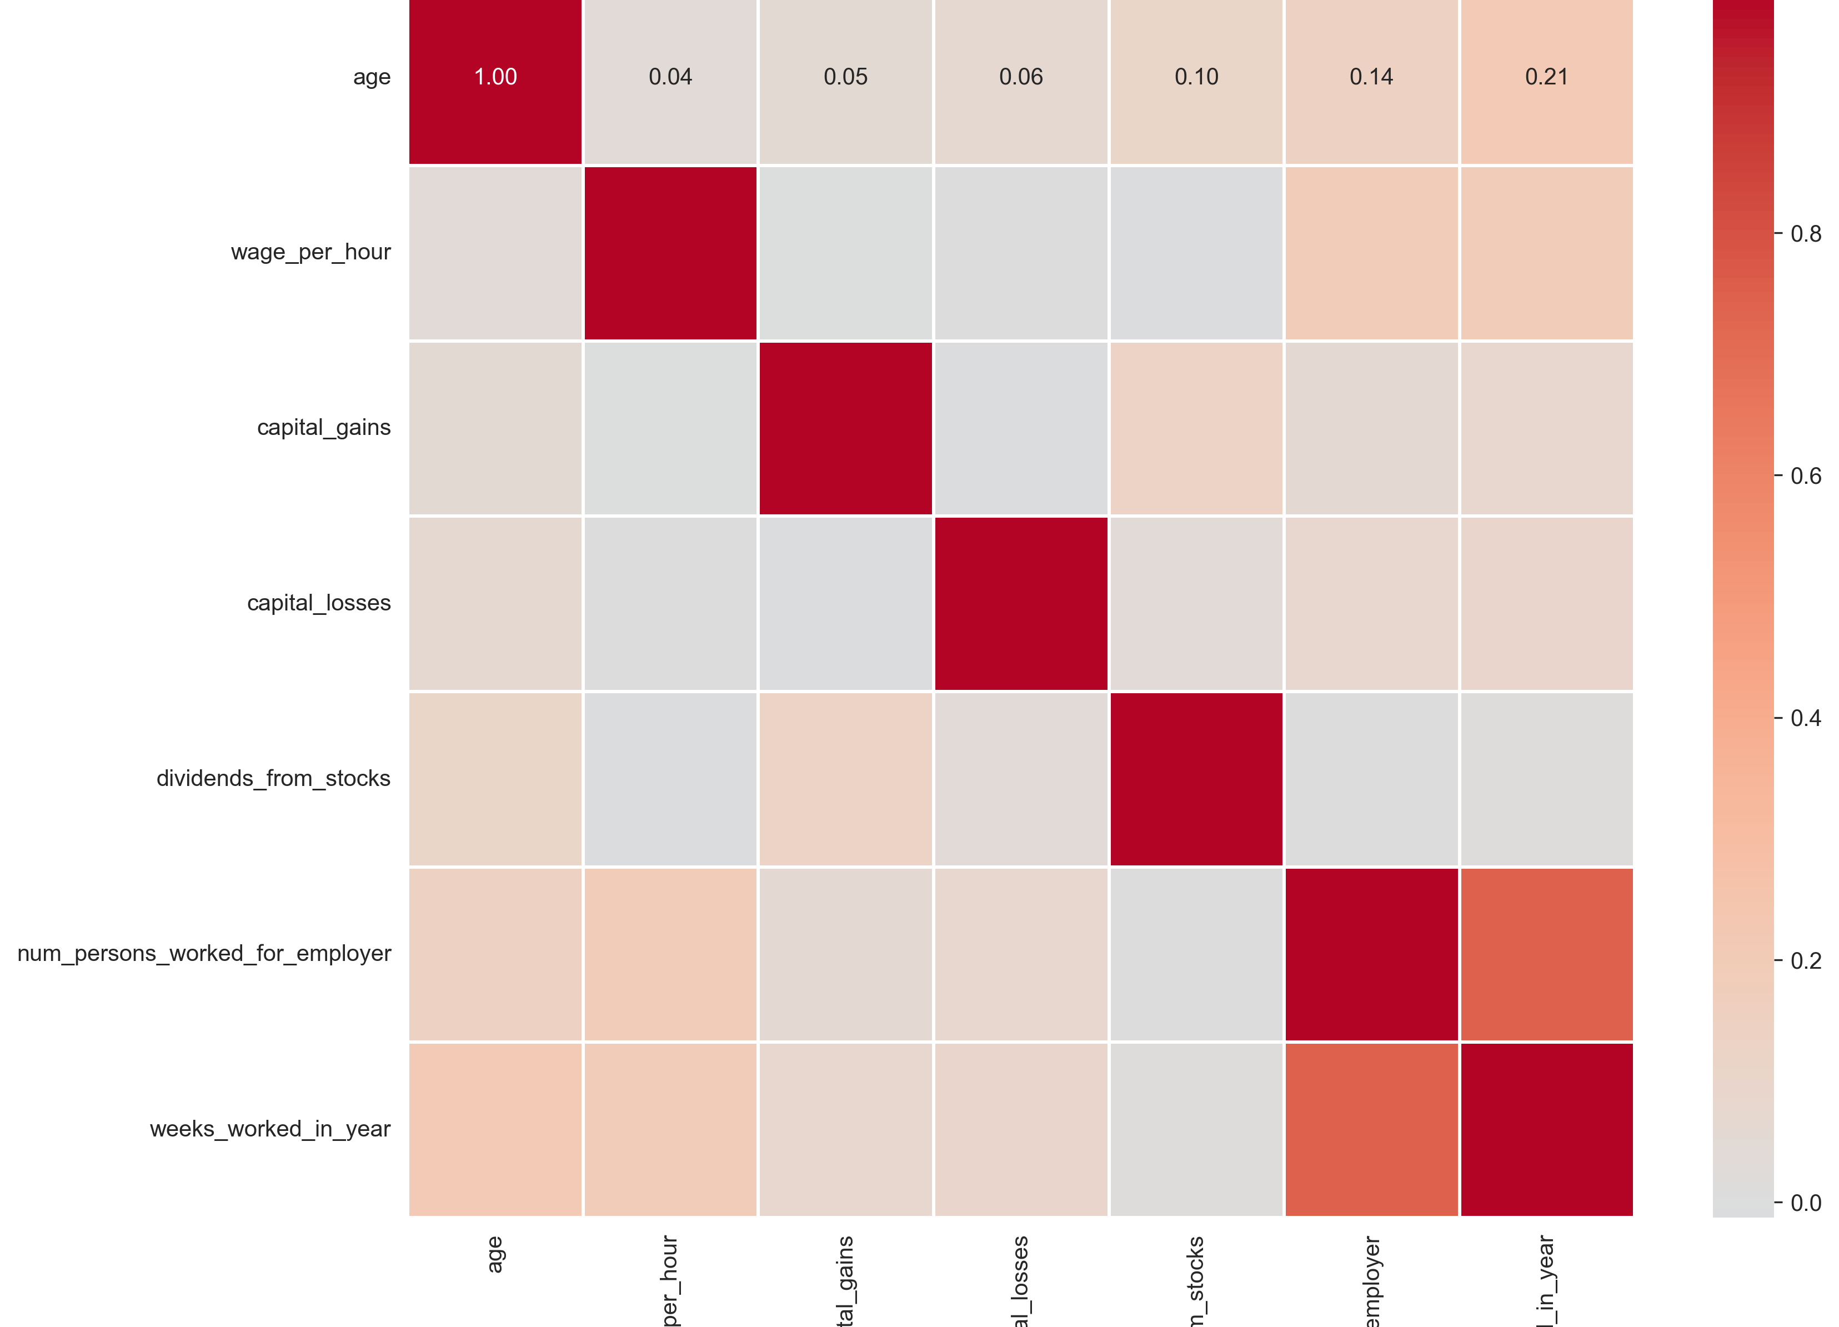
3. EDA - Correlations
Key Insights:
- Strong correlation between weeks_worked and num_persons_worked_for_employer (0.75)
- Age moderately correlates with weeks worked (0.21)
- Financial variables relatively independent

Slide 11
4. Data Preprocessing
Data Cleaning
- Removed instance_weight variable (per metadata guidelines)
- Stripped whitespace from all categorical variables
- Handled missing values in hispanic_origin column
- Standardized feature names for consistency
Encoding & Scaling
- Label Encoding: Applied to 29 categorical variables
- Standardization: Applied StandardScaler to 14 numerical features
- Ensured consistent encoding across train and test sets

Slide 12
5. Feature Engineering
Created 8 New Features
1. age_group: Categorical bins (18-25, 26-35, 36-45, 46-55, 56-65, 65+)
2. has_capital_gains: Binary indicator (0/1)
3. has_capital_losses: Binary indicator (0/1)
4. has_dividends: Binary indicator (0/1)
5. total_capital: Combined financial metric (gains - losses + dividends)
6. work_intensity: Proportion of year worked (weeks/52)
7. education_level: Ordinal encoding (0-15 scale)
8. is_native_born: Binary indicator for US-born
Result: 47 total features for modeling

Slide 13
6. Model Development
Models Tested
1. Logistic Regression - Linear baseline
2. Decision Tree - Interpretable non-linear
3. Random Forest - Ensemble of trees
4. Gradient Boosting - Sequential ensemble
5. XGBoost - Optimized gradient boosting

Slide 14
6. Model Development
Evaluation Strategy
- Used provided train/test split
- SMOTE balancing: Applied once to create 280,711 balanced training samples
- Fair comparison: All models trained on IDENTICAL balanced data
- Multiple metrics: Accuracy, F1-Score, ROC-AUC, Recall
- Primary Metric: ROC-AUC (best for imbalanced data evaluation)

Slide 15
7. Model Comparison Results
Model | Test Accuracy | Test F1 | Test AUC | Status
Gradient Boosting | 95.07% | 0.600 | 0.949 | Winner
XGBoost | 94.94% | 0.598 | 0.949 | 2
Random Forest | 94.00% | 0.583 | 0.948 | 3
Decision Tree | 92.01% | 0.514 | 0.926 | 4
Logistic Regression | 90.51% | 0.48 | 0.924 | 5

Slide 16
7. Model Comparison Results
Winner: Gradient Boosting (Best overall: 0.949 ROC-AUC, 0.600 F1)
- All models trained on same SMOTE-balanced data (280,711 samples)
- Fair apples-to-apples comparison with no model-specific weighting

Slide 17
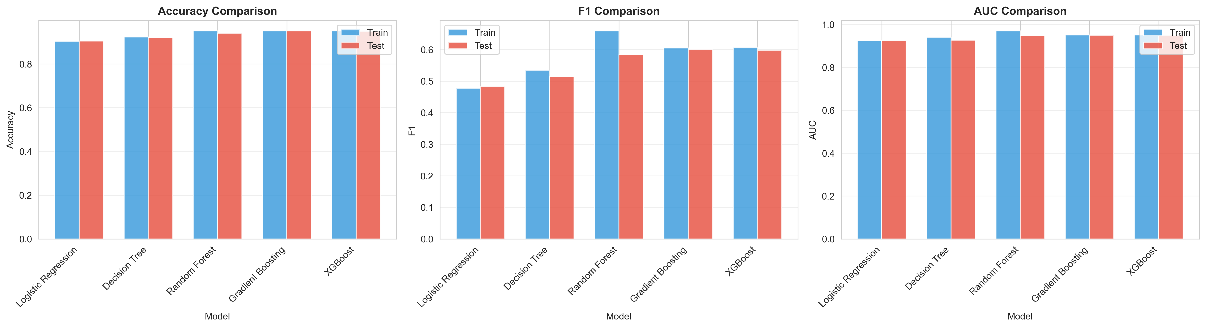
7. Model Comparison Results

Slide 18
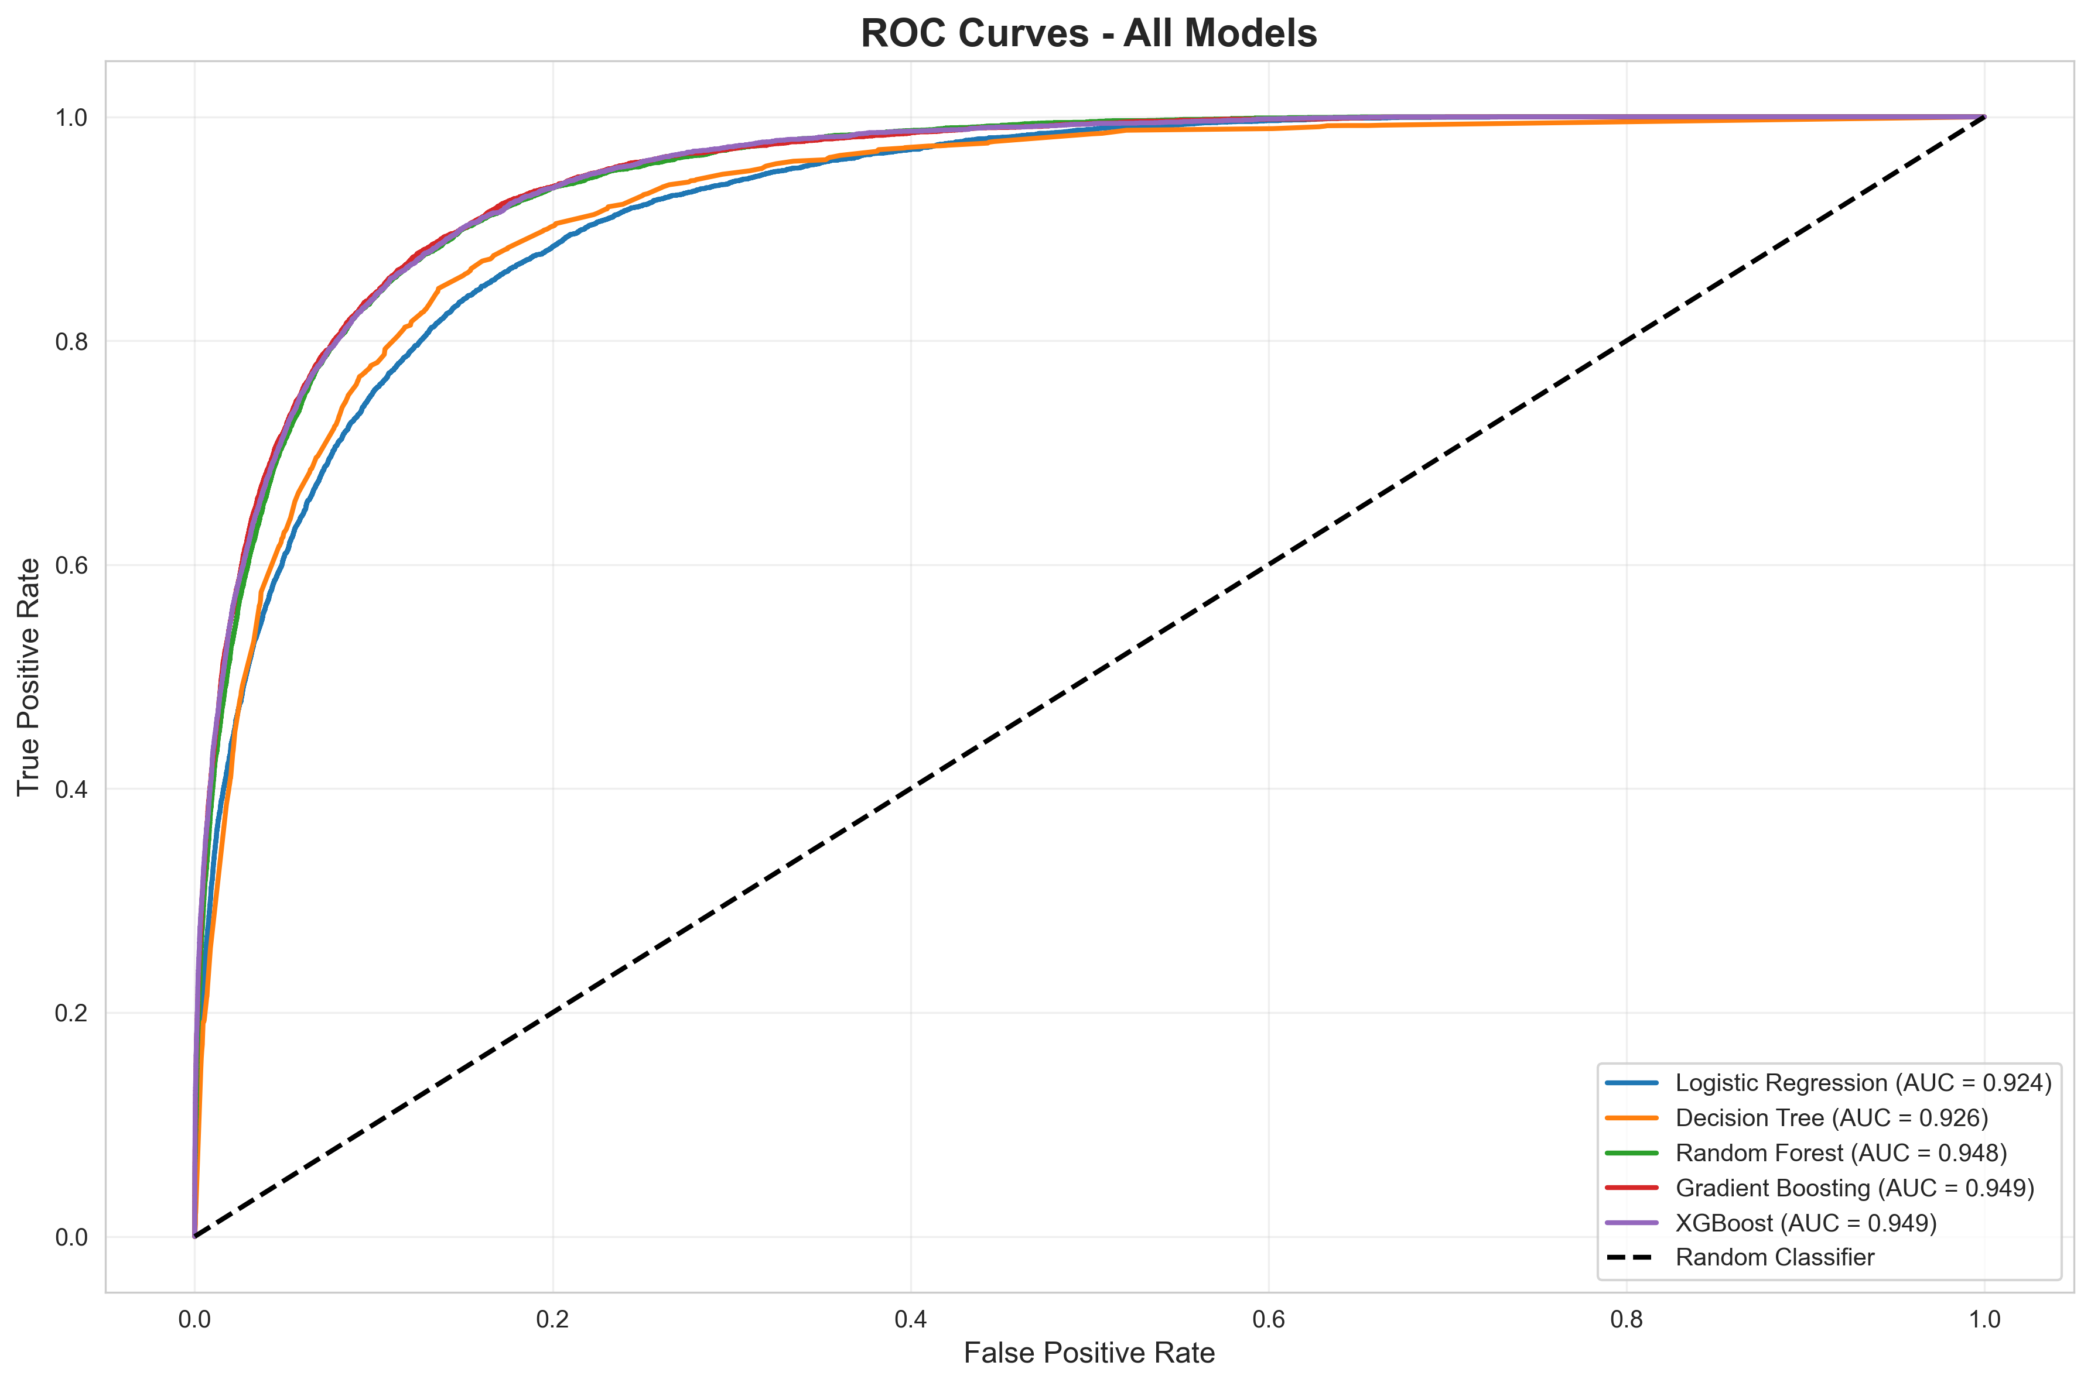
7. ROC Curves
Key Insight: All models significantly outperform random classifier
- Gradient Boosting and XGBoost show nearly identical ROC curves (0.949)
- Random Forest close behind (0.948)
- Excellent discrimination ability across all ensemble methods
- Tree-based models consistently outperform logistic regression

Slide 19
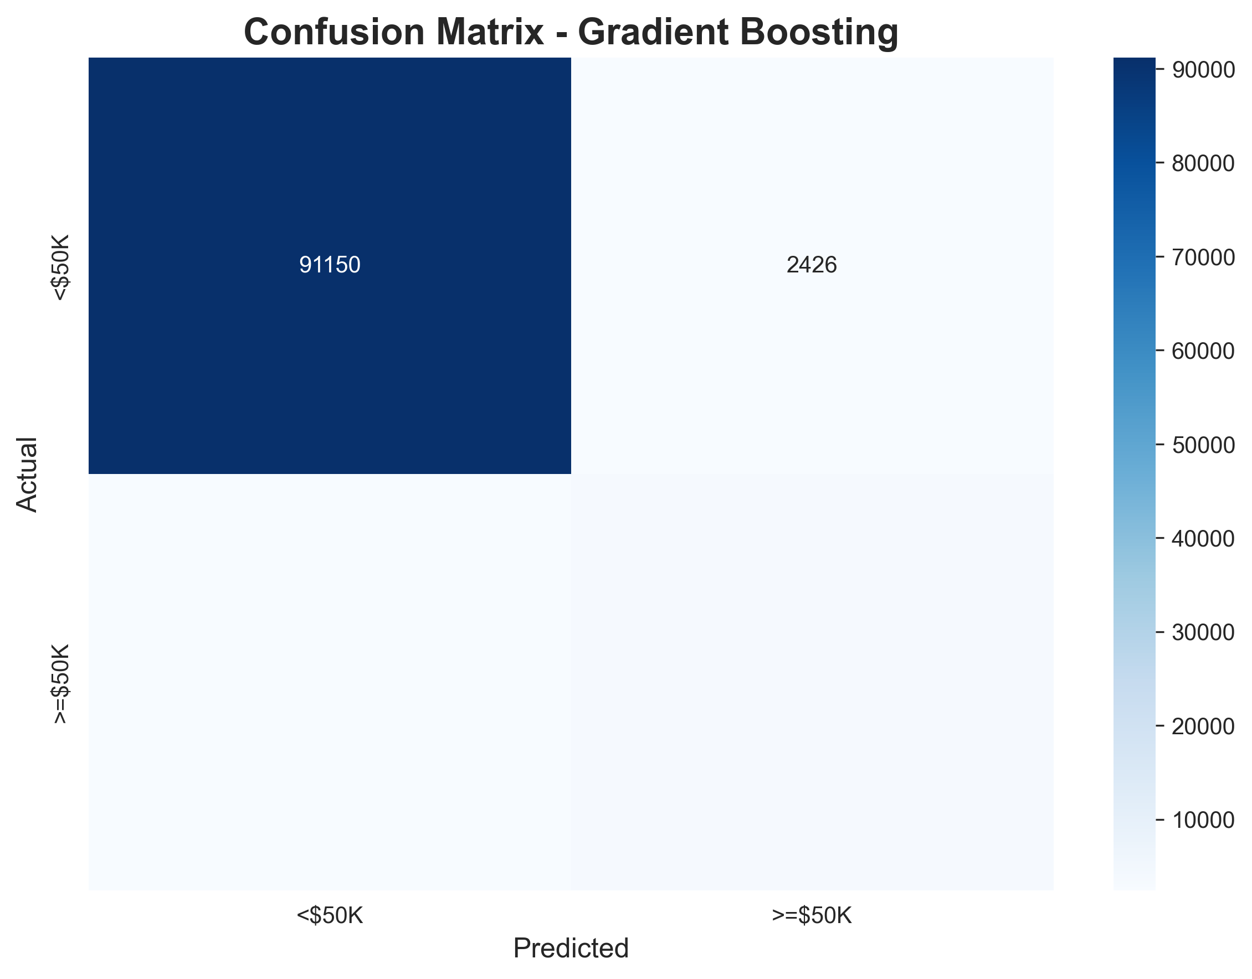
7. Confusion Matrix - Gradient Boosting
Performance Breakdown (Default Threshold = 0.50)
- True Negatives: 91,064 (correctly identified <$50K)
- True Positives: 3,692 (correctly identified ≥$50K)
- False Positives: 2,512 (predicted high, actually low)
- False Negatives: 2,494 (predicted low, actually high)
Recall for ≥$50K: 60% - Significant improvement from baseline!

Slide 20
7. Classification Metrics
Class | Precision | Recall | F1-Score | Support
<$50K | 0.97 | 0.97 | 0.97 | 93,576
≥$50K | 0.60 | 0.60 | 0.60 | 6,186
Interpretation
- Precision (≥$50K): 60% - When model predicts high income, correct 60% of time
- Recall (≥$50K): 60% - Model identifies 60% of actual high earners
- Balanced Performance: SMOTE successfully balanced precision-recall tradeoff
- With Threshold Tuning (0.45): Recall improves to 64.4%

Slide 21
8. Feature Importance
Top 5 Predictors (Gradient Boosting):
1. Education Level (43.8%) - Dominant factor by far!
2. Total Capital (12.9%) - Financial assets
3. Dividends from Stocks (7.0%) - Investment income
4. Age (6.3%) - Experience/career stage
5. Num Persons Worked For (5.3%) - Employment stability

Slide 22
8. Key Findings - Education
Education is the #1 Predictor (43.8% importance)
Income by Education Level
- Advanced Degrees (PhD, Professional, Masters): Highest probability of ≥$50K
- Bachelor's Degree: Strong positive correlation
- High School or Less: Strong negative correlation
- Education alone explains nearly half of income variation

Slide 23
Key Findings - Education
Actionable Insight
- Education policy investments have MASSIVE economic impact
- Support for higher education access could dramatically increase income levels
- Focus on STEM and professional degree programs
- ROI on education investment is quantifiably large

Slide 24
8. Key Findings - Financial Assets
Capital & Investments (#2, 12.9% + #3, 7.0% = 19.9% combined)
Patterns
- Most <$50K earners have zero capital gains/dividends
- Presence of investments strongly predicts ≥$50K
- Total capital (gains + dividends - losses) is powerful predictor
- Dividends alone contribute 7.0% to predictions

Slide 25
8. Key Findings - Financial Assets
Actionable Insight
- Wealth accumulation strongly correlates with income
- Financial literacy and investment access important
- Compound effect: higher income enables investment
- Support programs for retirement savings and investment education

Slide 26
8. Key Findings - Demographics
Age Patterns (#4, 6.3% importance)
Career Lifecycle Analysis
- Peak earning ages: 46-55 years (16.3% high earners)
- Young adults 18-25: Only 0.2% high earners
- 16.1 percentage point spread proves age binning relevance
- Mid-career (36-45): 13.1% high earners
- Pre-retirement (56-65): 10.2% high earners
Employment Stability (#5, 5.3% importance)
- Number of persons worked for indicates job stability
- Continuous employment associated with higher income

Slide 27
8. Key Findings - Demographics
Actionable Insight
- Support mid-career advancement programs (ages 35-55)
- Focus on employment stability initiatives
- Career development programs for young workers

Slide 28
9. Business Recommendations
Education Investment
- Expand access to higher education programs
- Support for vocational and professional training
- Student loan assistance and scholarship programs
Employment Stability
- Job creation focusing on full-time positions
- Unemployment assistance and job training
- Support for career advancement

Slide 29
9. Business Recommendations
Equity Initiatives
- Address gender-based income disparities
- Equal pay enforcement
- Minority community support programs

Slide 30
10. Limitations
1. Class Imbalance -
- Original: 93.8% vs 6.2% (15:1 ratio)
- Solution: SMOTE balancing improved recall from 46% → 64%
- All models now train on same balanced data
2. Temporal Scope (1994-1995 data)
- Economic conditions have changed significantly
- May not reflect current labor market

Slide 31
10. Limitations
3. Feature Limitations
- No geographic granularity below state level
- Missing cost-of-living adjustments
- No household composition details
4. Correlation vs Causation
- Findings show associations, not causal relationships
- Cannot infer policy interventions will have predicted effects

Slide 32
Thank you

